Slide 1
Testing with Routines and Libraries

Slide 2
Reasons to Create a Routine
Avoid duplicating code
Documentation value (a simple abstraction)
Reduce or hide complexity
Hide required sequences
think of a hardware-specific initialization
Improve portability
Aid readability

Slide 3
Design at the Routine Level should revolve around the principle of cohesion – a routine's operations should be related
Functional Cohesion is ideal – the routine performs only one operation
Less ideal are:
Sequential Cohesion – steps in a routine must be performed in the specified order
Communicational Cohesion – uses the same data, but to different purposes
Temporal Cohesion – operations that happen at the same time

Slide 4
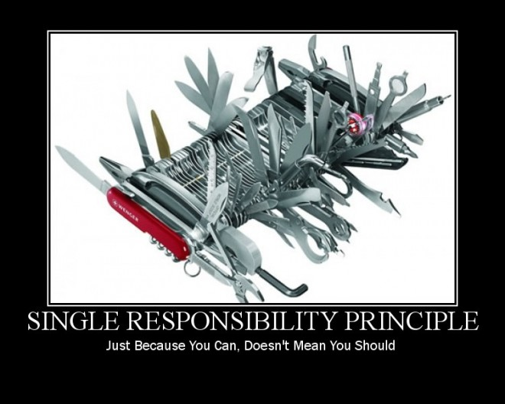

Slide 5
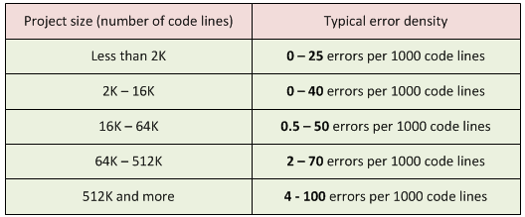
What is the best length for a routine?
Some people say 50-100 lines
IBM once required that no routine should exceed 50 lines
TRW limited them to 2 pages in printout
People have spent lots of time studying this
No consensus
Be careful if you exceed 150 lines

Slide 6
Good routines have well-designed parameter lists
List params consistently in different routines
Use "self-documenting" names for formal parameters
Don't pass unused parameters
Limit number of parameters
Document assumptions

Slide 7
3rd Party Libraries
The standard Java libraries fail to provide enough methods for manipulation of its core classes.
Many 3rd party libraries exist to provide extra methods or convenience methods
Goal is to do common tasks easily
Apache Commons is a popular one
Commons Lang - utilities for the java.lang API, such as String manipulation methods, basic numerical methods, etc.
Commons IO - utilities to assist with developing IO functionality
Log4j, Joda Time, etc.

Slide 8
3rd Party Libraries
Examples we will look at today:
Apache Commons Lang
https://commons.apache.org/proper/commons-lang/download_lang.cgi
Apache Commons IO
http://commons.apache.org/proper/commons-io/download_io.cgi
Download the binaries and unzip
You will find jar files
Download the source (optional)
To see implementation

Slide 9
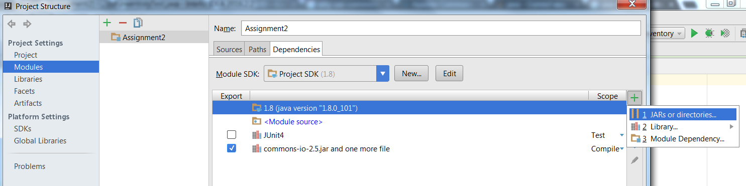
Adding 3rd Party Libraries to IntelliJ
1
Open IntelliJ then go to File -> Project Structures
2
3
4

Slide 10
There has be a better way…
Yes!!! There is a better way
You can use Gradle or Maven
Search at http://mvnrepository.com/

Slide 11

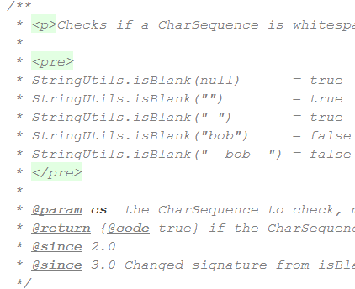
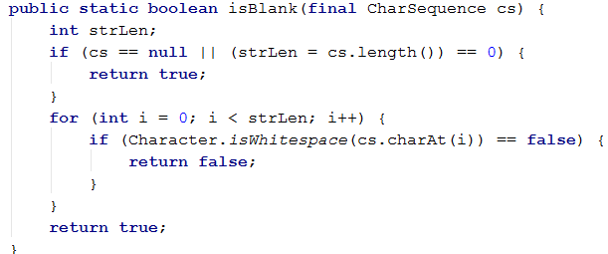
Example Uses of Common Lang
StringUtils Class

Slide 12
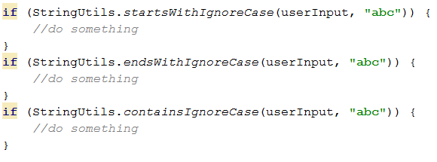
Example Uses of Common Lang
StringUtils Class
Not available in the standard java API
No need to reinvent the wheel
Use 3rd party library
Code is well tested and actively maintained

Slide 13


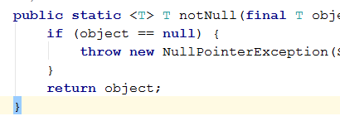

Many More in Common Lang
ArrayUtils
RandomStringUtils / RandomUtils
When would this be super useful?
Validate
Notes:
Update: RandomStringUtils deprecated use,
RandomStringGenerator generator = new RandomStringGenerator.Builder() .withinRange('a', 'z').build();
String randomLetters = generator.generate(20);

Slide 14
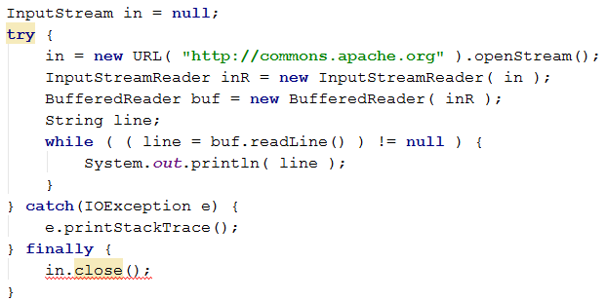
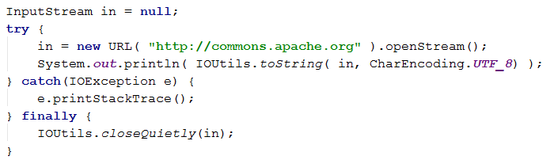
Example Uses of Common IO
VS

Slide 15
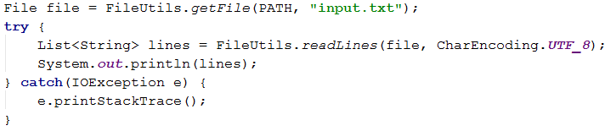
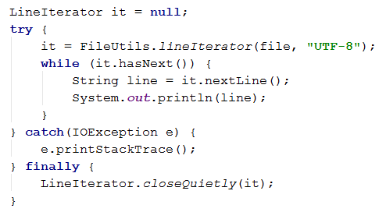
Working with Files

Slide 16
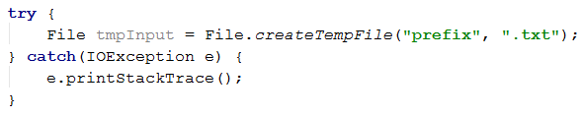
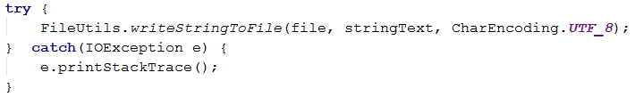
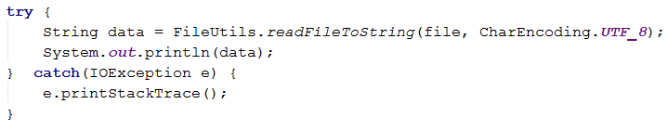
Working with Files
When would this be useful?

Slide 17
Popular 3rd Party Libraries
Apache Commons
Google Guava
SpringFramework.Util

Slide 18
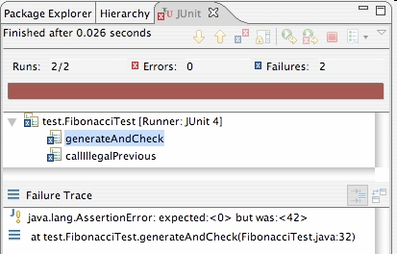
JUnit: Good assertion messages
public class DateTest {
@Test
public void test_addDays_addJustOneDay_1() {
Date actual = new Date(2050, 2, 15);
actual.addDays(1);
Date expected = new Date(2050, 2, 16);
assertEquals("adding one day to 2050/2/15",
expected, actual);
}
...
}
// JUnit will already show
// the expected and actual
// values in its output;
//
// don't need to repeat them
// in the assertion message

Slide 19
Timeouts in Test Methods
You can limit how long a method is allowed to take
This is good protection against infinite loops
The time limit is specified in milliseconds
The test fails if the method takes too long
@Test (timeout=10) public void greatBig() { assertTrue(program.ackerman(5, 5) > 10e12); }
Some method calls should throw an exception
You can specify that a particular exception is expected
The test will pass if the expected exception is thrown, and fail otherwise
@Test (expected=IllegalArgumentException.class) public void factorial() { program.factorial(-5); }
Notes:
For an interesting discussion of Ackerman’s function watch: https://www.youtube.com/watch?v=i7sm9dzFtEI

Slide 20
Tests with a timeout
@Test(timeout = 5000)
public void name() { ... }
The above method will be considered a failure if it doesn't finish running within 5000 ms
private static final int TIMEOUT = 2000;
...
@Test(timeout = TIMEOUT)
public void name() { ... }
Times out / fails after 2000 ms

Slide 21
Pervasive timeouts
public class DateTest {
@Test(timeout = DEFAULT_TIMEOUT)
public void test_addDays_withinSameMonth_1() {
Date d = new Date(2050, 2, 15);
d.addDays(4);
Date expected = new Date(2050, 2, 19);
assertEquals("date after +4 days", expected, d);
}
@Test(timeout = DEFAULT_TIMEOUT)
public void test_addDays_wrapToNextMonth_2() {
Date d = new Date(2050, 2, 15);
d.addDays(14);
Date expected = new Date(2050, 3, 1);
assertEquals("date after +14 days", expected, d);
}
// almost every test should have a timeout so it can't
// lead to an infinite loop; good to set a default, too
private static final int DEFAULT_TIMEOUT = 2000;
}

Slide 22
Ignoring a test
The @Ignore annotation says to not run a test
@Ignore("I don’t want Dr. Im to know this doesn’t work") @Test public void testInventory() { assertEquals(3,inv.size()); }
You shouldn’t use @Ignore without a very good reason!

